Slide 1

Supervised Learning: Linear & Logistic Regression
Lauren Vanderlinden, PhD, MS
T15 Postdoctoral Fellow Computational Biology
Division of Rheumatology & Department of Biomedical Informatics
School of Medicine, University of Colorado Anschutz Medical Campus
CPBS 7602 - December 2, 2024

Slide 2
Outline
Analyses and Measurements of Error
Simple Linear Regression
Multiple Linear Regression
Interaction Terms
Logistic Regression

Slide 3
Why Would We Use Analyses?

Slide 4
Simple Statistical Model
All statistical models can be represented by the equation:
response_{i} = model + error_{i}
This means that every response can be predicted from the model we choose to fit to the data plus come error.

Slide 5
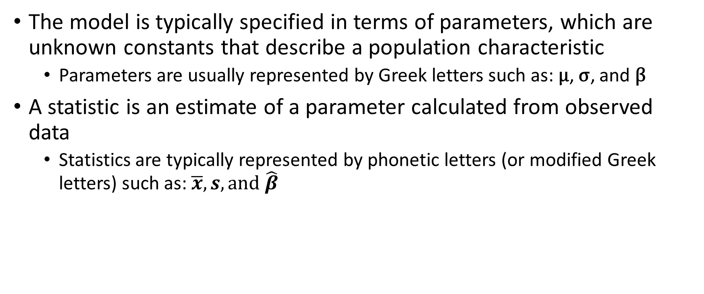
Simple Statistical Model (Cont.)
The model is typically specified in terms of parameters, which are unknown constants that describe a population characteristic
Parameters are usually represented by Greek letters such as: µ, σ, and β
A statistic is an estimate of a parameter calculated from observed data
Statistics are typically represented by phonetic letters (or modified Greek letters) such as: $\overline{x}, s, and \hat{β}$

Slide 6
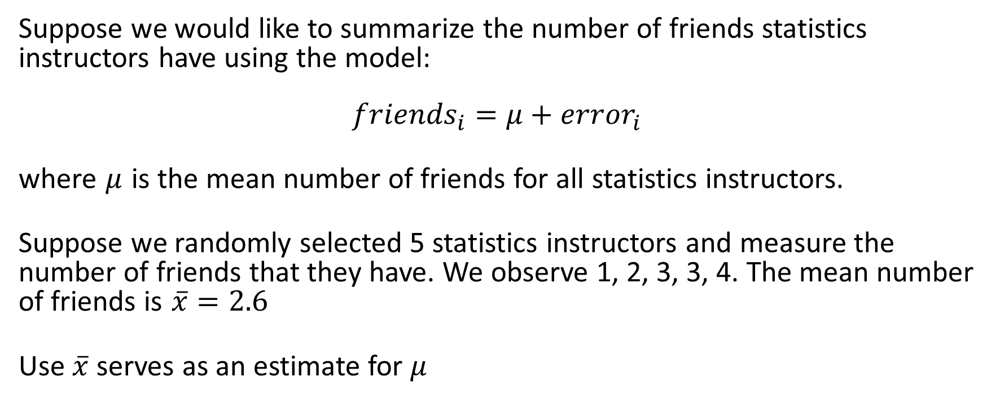
Example: the mean as a statistical model
Suppose we would like to summarize the number of friends statistics instructors have using the model:
$${friends}_{i}=μ+{error}_{i}$$
where $μ$ is the mean number of friends for all statistics instructors.
Suppose we randomly selected 5 statistics instructors and measure the number of friends that they have. We observe 1, 2, 3, 3, 4. The mean number of friends is $\overline{x}=2.6$
Use $\overline{x}$ serves as an estimate for $μ$

Slide 7
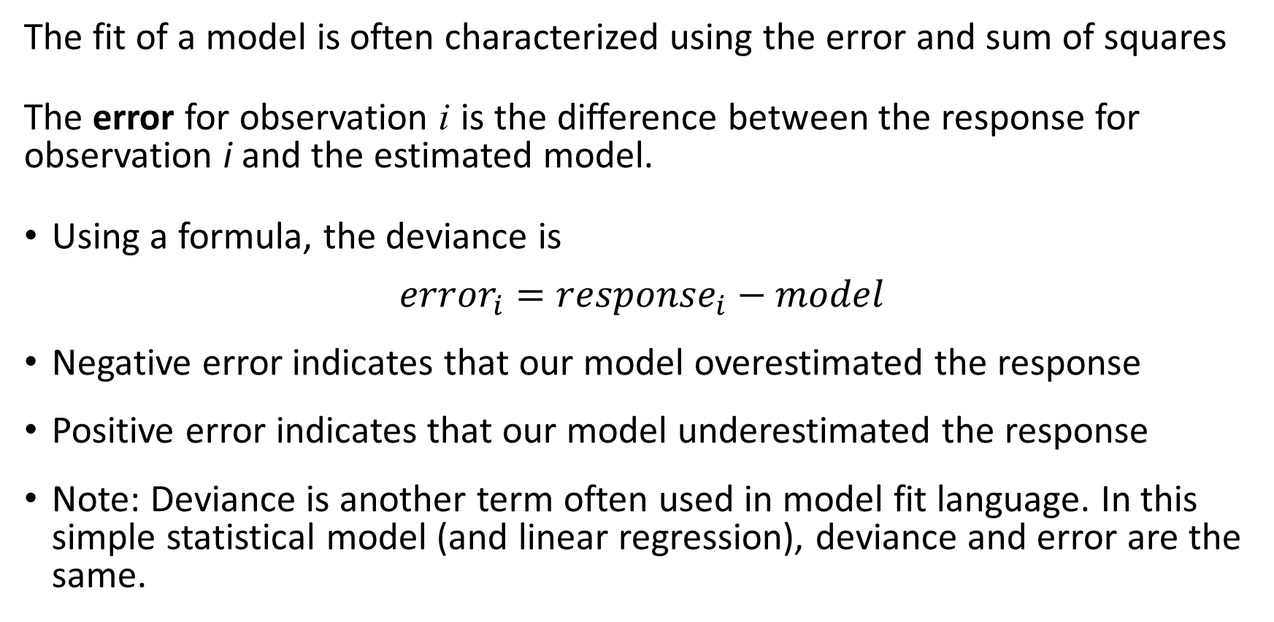
Assessing model fit
The fit of a model is often characterized using the error and sum of squares
The error for observation i is the difference between the response for observation i and the estimated model.
Using a formula, the deviance is
$${error}_{i}={response}_{i}−model$$
Negative error indicates that our model overestimated the response
Positive error indicates that our model underestimated the response
Note: Deviance is another term often used in model fit language. In this simple statistical model (and linear regression), deviance and error are the same.

Slide 8
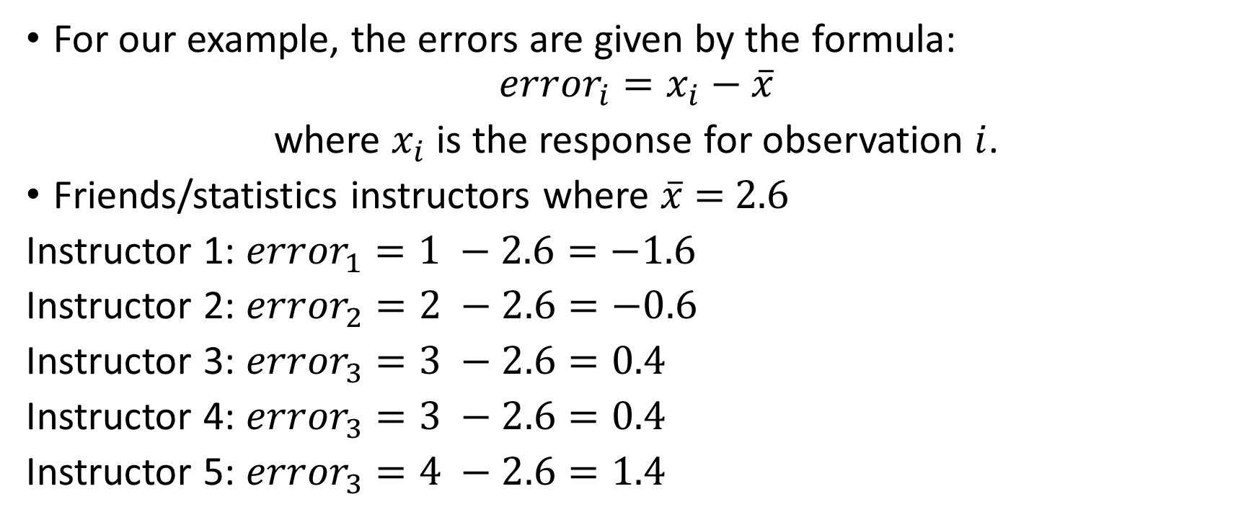
Example: error
For our example, the errors are given by the formula:
$${error}_{i}=x_{i}−\overline{x}$$
where $x_{i}$ is the response for observation $i$.
Friends/statistics instructors where $\overline{x}$ = 2.6
Instructor 1: ${error}_{1}=1 −2.6=−1.6$
Instructor 2: ${error}_{2}=2 −2.6=−0.6$
Instructor 3: ${error}_{3}=3 −2.6=0.4$
Instructor 4: ${error}_{3}=3 −2.6=0.4$
Instructor 5: ${error}_{3}=4 −2.6=1.4$

Slide 9
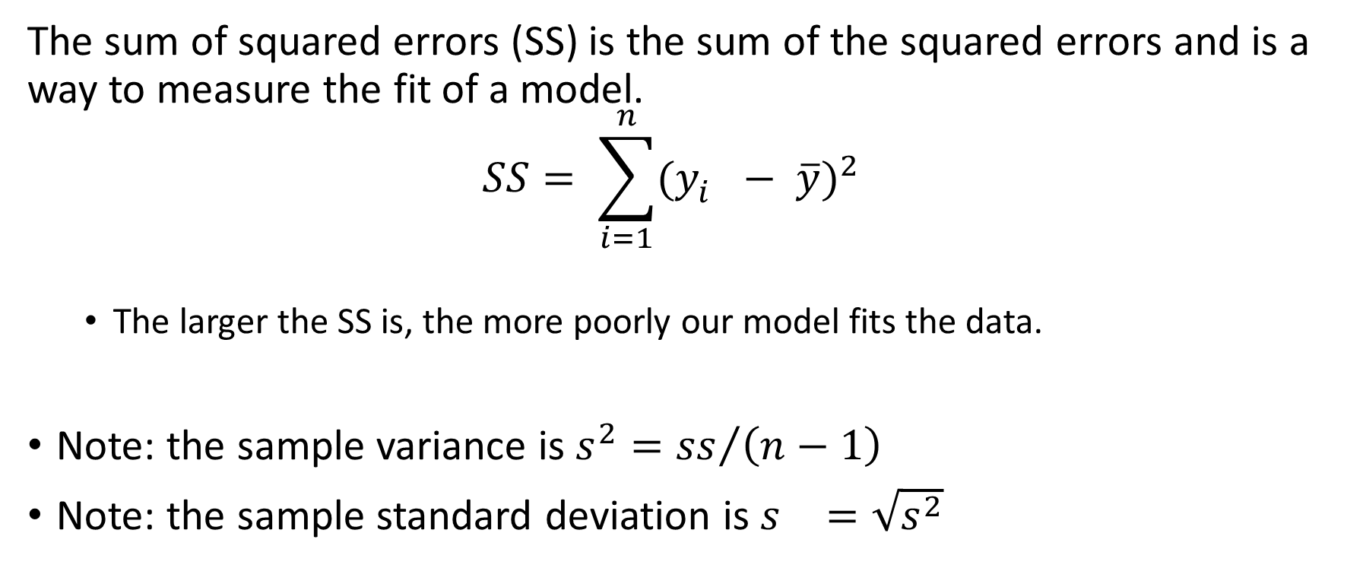
Sum of squared errors
The sum of squared errors (SS) is the sum of the squared errors and is a way to measure the fit of a model.
$$SS= \sum_{i=1}^{n}{{(y_{i}^{}− \overline{y})}^{2}}$$
The larger the SS is, the more poorly our model fits the data.
Note: the sample variance is $s^{2}={ss}/{\left(n−1\right)}$
Note: the sample standard deviation is $s^{}=\sqrt{s^{2}}$

Slide 10
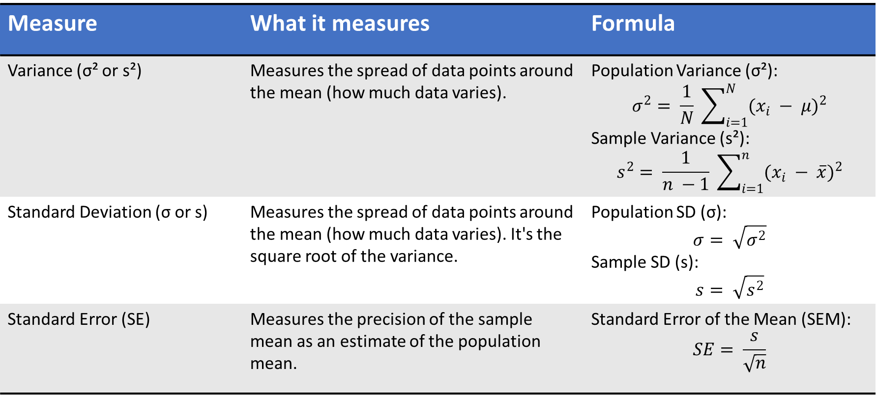
Comparison of variability measures
Measure | What it measures | Formula
Variance (σ² or s²) | Measures the spread of data points around the mean (how much data varies). | Population Variance (σ²): $$σ^{2}= \frac{1}{N} \sum_{i=1}^{N}{{(x_{i} − μ)}^{2}}$$ Sample Variance (s²): $$s^{2}= \frac{1}{n −1} \sum_{i=1}^{n}{{(x_{i} − \overline{x})}^{2}}$$
Standard Deviation (σ or s) | Measures the spread of data points around the mean (how much data varies). It's the square root of the variance. | Population SD (σ): $$σ= \sqrt{σ^{2}}$$ Sample SD (s): $$s= \sqrt{s^{2}}$$
Standard Error (SE) | Measures the precision of the sample mean as an estimate of the population mean. | Standard Error of the Mean (SEM): $$SE= \frac{s}{\sqrt{n}}$$

Slide 11
Regression Analysis

Slide 12
What is regression?
Regression analysis provides a way of describing the distribution of a response (outcome/dependent) variable as a function of one or more explanatory (predictor/independent) variables.
The regression of the response variable on the explanatory variable described the mathematical relationship between the response variable and the explanatory variable.

Slide 13
Simple Linear Regression
Regression Analyses

Slide 14
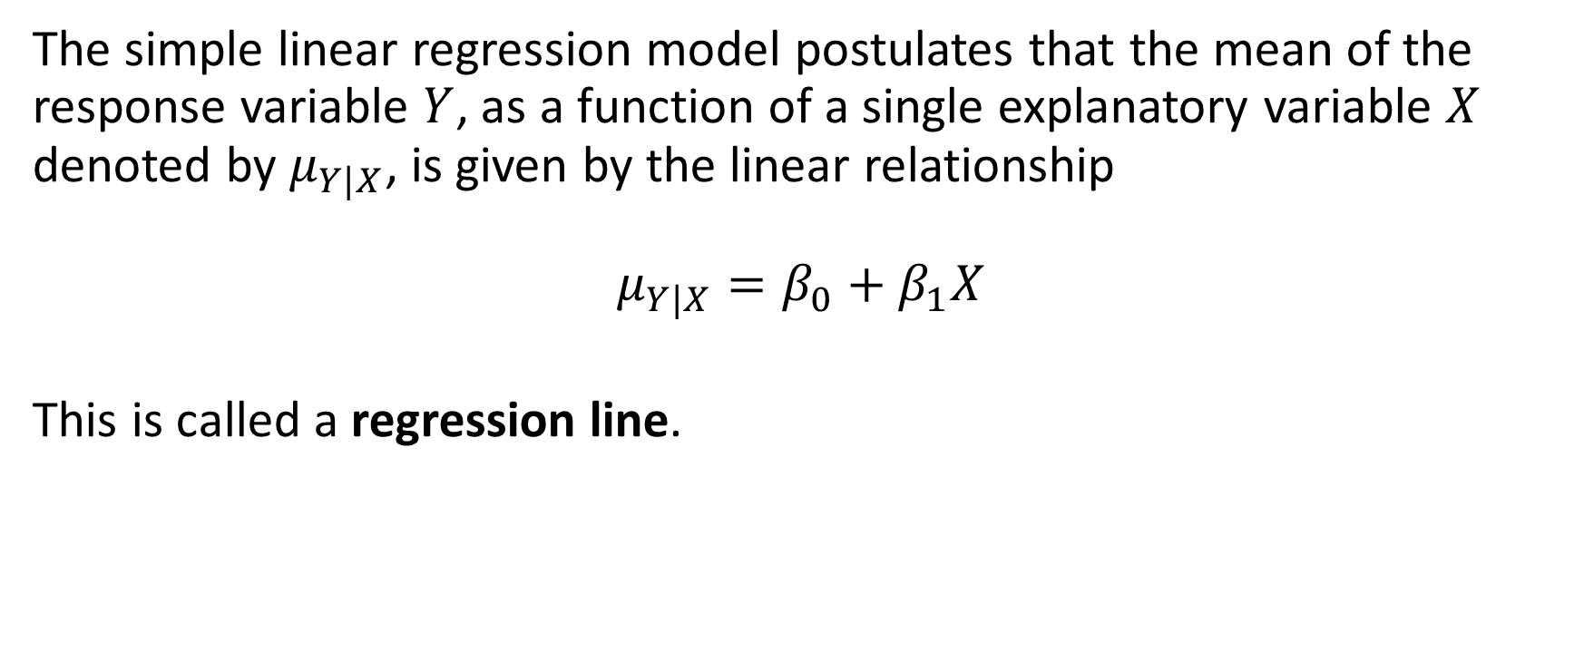
Simple Linear Regression Model
The simple linear regression model postulates that the mean of the response variable $Y$, as a function of a single explanatory variable $X$ denoted by $μ_{Y|X}$, is given by the linear relationship
$$μ_{Y|X}=β_{0}+β_{1}X$$
This is called a regression line.

Slide 15
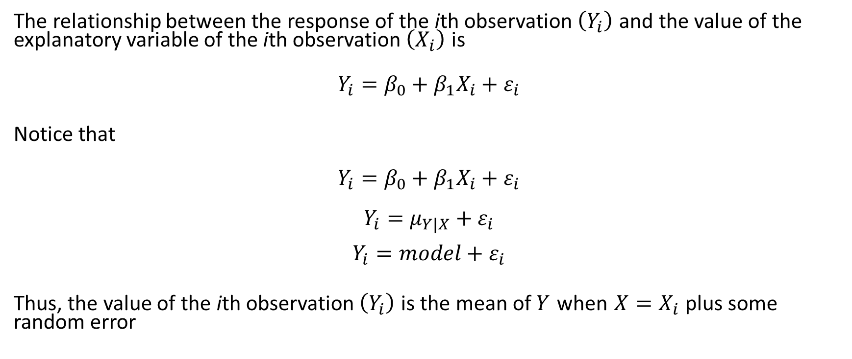
Relationship between Y_{i} and X_{i}
The relationship between the response of the ith observation $\left(Y_{i}\right)$ and the value of the explanatory variable of the ith observation $\left(X_{i}\right)$ is
$$Y_{i}=β_{0}+β_{1}X_{i}+ε_{i}$$
Notice that
$$Y_{i}=β_{0}+β_{1}X_{i}+ε_{i}$$
$Y_{i}=μ_{Y|X}+ε_{i}$
$$Y_{i}=model+ε_{i}$$
Thus, the value of the ith observation $\left(Y_{i}\right)$ is the mean of $Y$ when $X=X_{i}$ plus some random error

Slide 16
Terms in a simple linear regression model
β₀ is the intercept of the model
It is the mean value for Y when X = 0.
It is where the regression line crosses the y-axis.
β₁ is the slope of the model
It is the mean change in Y when the explanatory variable X increases by 1 unit.
Describes how the response variable is affected by the explanatory variable.
β₀ and β₁ are called regression coefficients.

Slide 17
Relationship between intercepts and slopes

Slide 18
Best fit line for the data
We want to describe the relationship between the response variable and the explanatory variable with a regression line.
How do we decide which model is the “best” model since there are many possible straight lines?

Slide 19
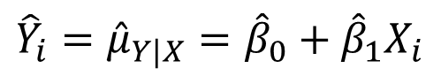
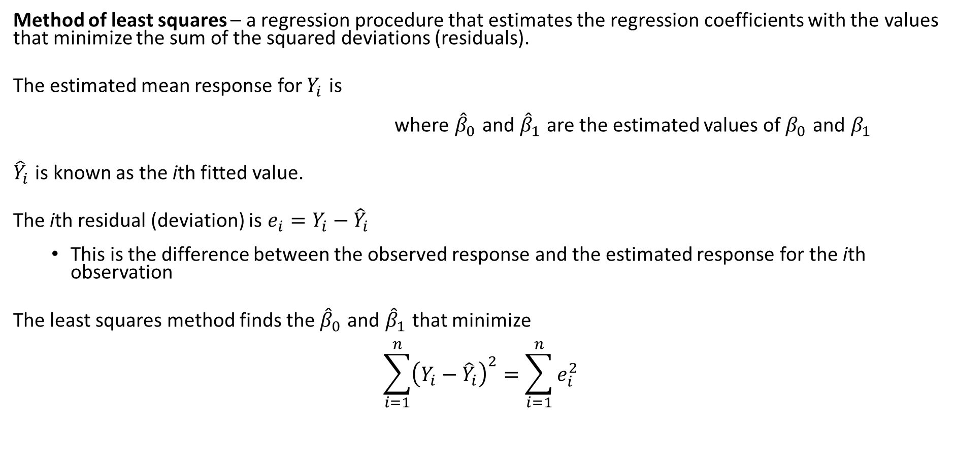
Method of least squares
Method of least squares – a regression procedure that estimates the regression coefficients with the values that minimize the sum of the squared deviations (residuals).
The estimated mean response for $Y_{i}$ is
where ${\hat{β}}_{0}$ and ${\hat{β}}_{1}$ are the estimated values of $β_{0}$ and $β_{1}$
${\hat{Y}}_{i}$ is known as the ith fitted value.
The ith residual (deviation) is $e_{i}=Y_{i}−{\hat{Y}}_{i}$
This is the difference between the observed response and the estimated response for the ith observation
The least squares method finds the ${\hat{β}}_{0}$ and ${\hat{β}}_{1}$ that minimize
$$\sum_{i=1}^{n}{{\left(Y_{i}−{\hat{Y}}_{i}\right)}^{2}}=\sum_{i=1}^{n}{e_{i}^{2}}$$
${\hat{Y}}_{i}={\hat{μ}}_{Y|X}={\hat{β}}_{0}+$ ${\hat{β}}_{1}X_{i}$

Slide 20
Goal: minimize those vertical dashed lines

Slide 21
Simple Linear Regression Example
A drug precursor molecule is extracted from a type of nut. The nuts are commonly contaminated by a fungal toxin that is difficult to remove during the purification process. We suspect that the amount of fungus (and hence toxin) depends on the rainfall at the growing site. We would like to predict toxin concentration from rainfall in order to judge whether it would be worth paying additional rental charges for relatively drier sites. We analyze the toxin content in a series of batches of nuts and we know the rainfall at the growing sites during the four months when the nuts are forming.

Slide 22
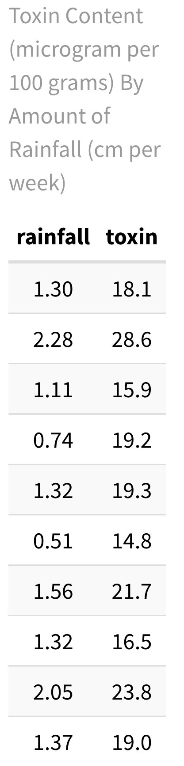
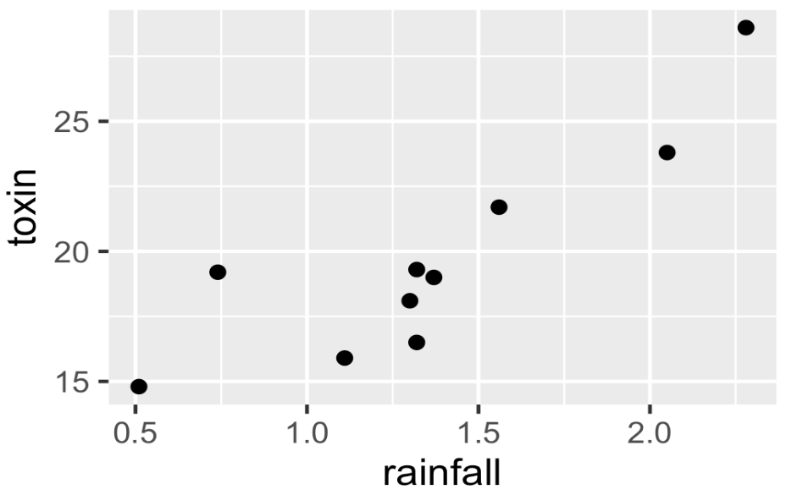

Slide 23
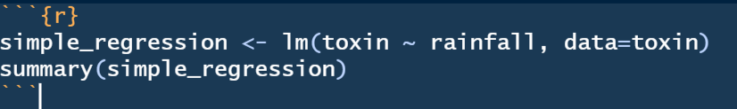
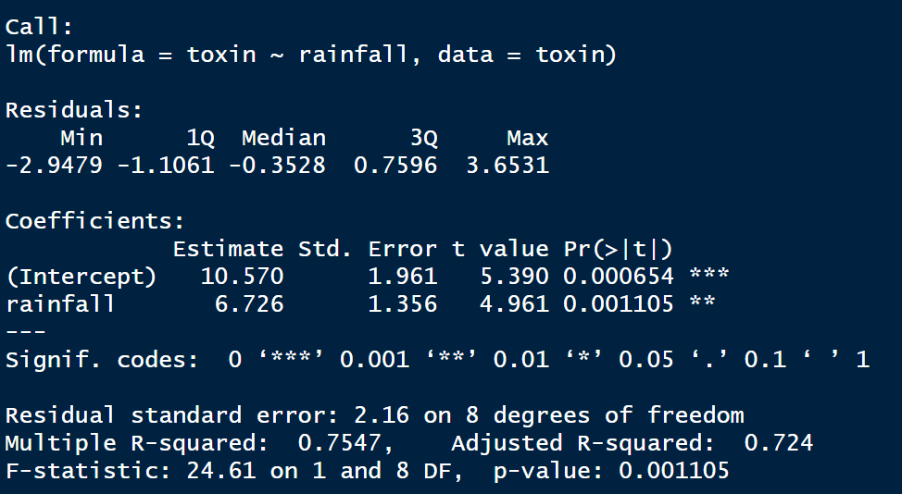
Code/Results in R

Slide 24
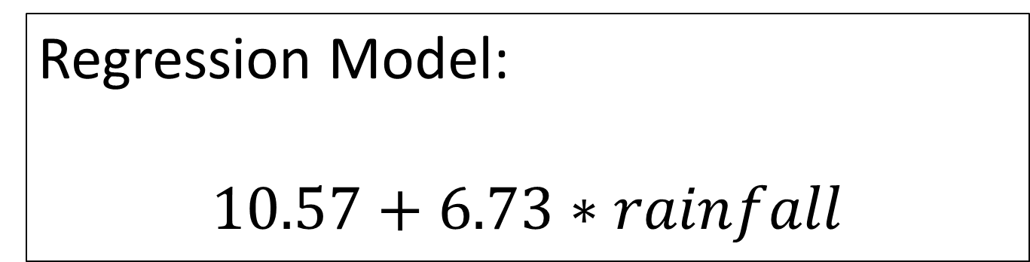
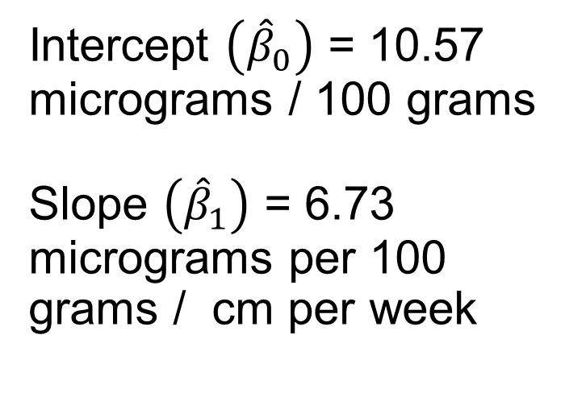
Intercept $\left({\hat{β}}_{0}\right)$ = 10.57 micrograms / 100 grams
Slope $\left({\hat{β}}_{1}\right)$ = 6.73 micrograms per 100 grams / cm per week
Regression Model:
$$10.57+6.73∗rainfall$$

Slide 25
Results from example
An increase in rainfall is significantly associated with an increase in nut toxin concentration (slope = 6.73, standard error = 1.36, p-value = 0.0011). The full regression model is toxin concentration = 10.57 + 6.73 * rainfall.

Slide 26
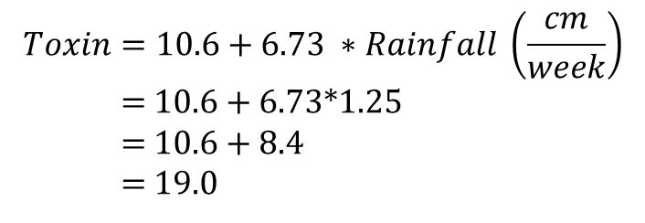
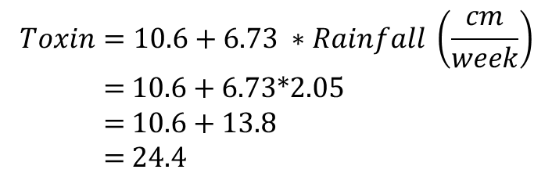
Making predictions using the regression equation
Having obtained the regression equation, we might now have the chance to rent two agricultural locations where we could grow a crop of nuts. We show that the weekly rainfall at Sites A and B during the fruiting season are 2.05 and 1.25 cm/week respectively. Therefore, we can predict the level of toxin in nuts grown at these two sites.
Site A:
Site B:
$$Toxin=10.6+6.73 ∗Rainfall \left(\frac{cm}{week}\right)$$
= 10.6 + 6.73*2.05
= 10.6 + 13.8
= 24.4
$$Toxin=10.6+6.73 ∗Rainfall \left(\frac{cm}{week}\right)$$
= 10.6 + 6.73*1.25
= 10.6 + 8.4
= 19.0

Slide 27
Interpolation and Extrapolation
Interpolation: A prediction using a value of the independent variable that is within the observed range - uncontroversial.
Extrapolation: A prediction using a value of the independent variable that lies outside the observed range. Extrapolation should be avoided unless there is sound reason to believe that the linear relationship extends beyond the observed range.

Slide 28
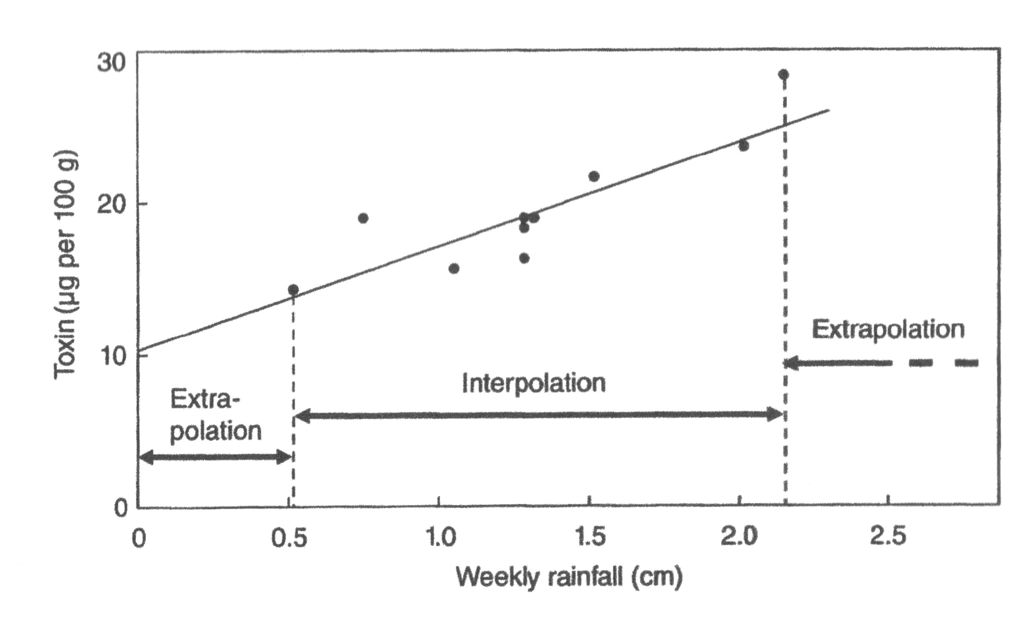

Slide 29
Summary of simple linear regression
A simple statistical model indicates that the response (dependent variable) equals the statistical model plus a sample-specific error.
Simple linear regression includes only one predictor variable.
The ‘intercept’ from a linear regression model is the average y value when x is zero. The ‘slope’ from a linear regression model is the average change in y when x is increased by one unit.

Slide 30
Multiple Linear Regression
Regression Analyses

Slide 31
Simple vs. Multiple Linear Regression
Simple linear regression - regression assuming that the relationship between a single explanatory variable and the response variable is linear.
Multiple linear regression - regression using multiple explanatory variables that assumes the relationship can be written as a linear equation.

Slide 32
Multiple Linear Regression
Multiple regression is a linear regression model with one response variable and multiple explanatory variables.
Our model is similar to before, but we have extra regression coefficients and explanatory variables.
Multiple regression is often used when we want to ‘control’ for a variable (i.e. confounders, precision covariates…)

Slide 33
Multiple Regression
The relationship between the response for the ith observation (Y_{i}) and the values for the explanatory variables for the ith observation
where X_{i1} is the value of the first explanatory variable for observation i, X_{i2} is the value of the second explanatory variable for the observation i, etc., and β_{j} is the regression coefficient for the jth explanatory variable.

Slide 34
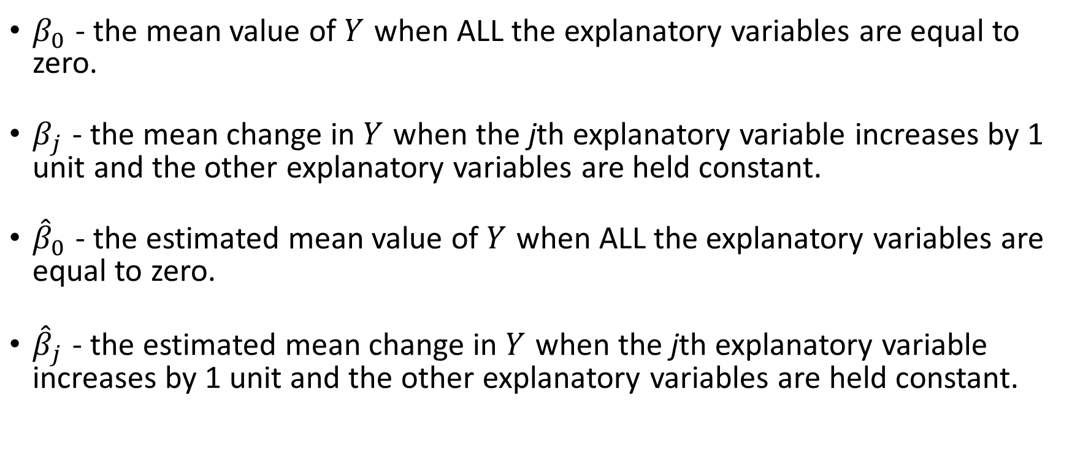
Interpretation of regression coefficients
$β_{0}$ - the mean value of $Y$ when ALL the explanatory variables are equal to zero.
$β_{j}$ - the mean change in $Y$ when the jth explanatory variable increases by 1 unit and the other explanatory variables are held constant.
${\hat{β}}_{0}$ - the estimated mean value of $Y$ when ALL the explanatory variables are equal to zero.
${\hat{β}}_{j}$ - the estimated mean change in $Y$ when the jth explanatory variable increases by 1 unit and the other explanatory variables are held constant.

Slide 35
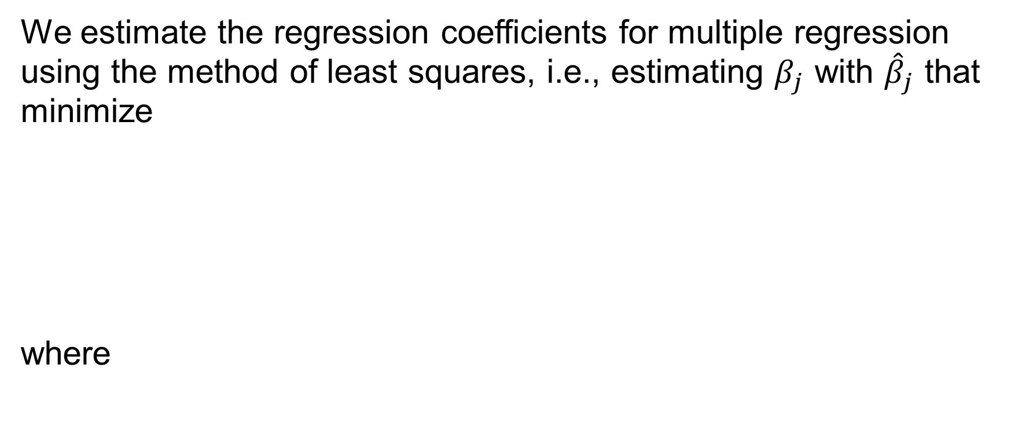
Estimating Regression Coefficients
We estimate the regression coefficients for multiple regression using the method of least squares, i.e., estimating $β_{j}$ with ${\hat{β}}_{j}$ that minimize
where

Slide 36
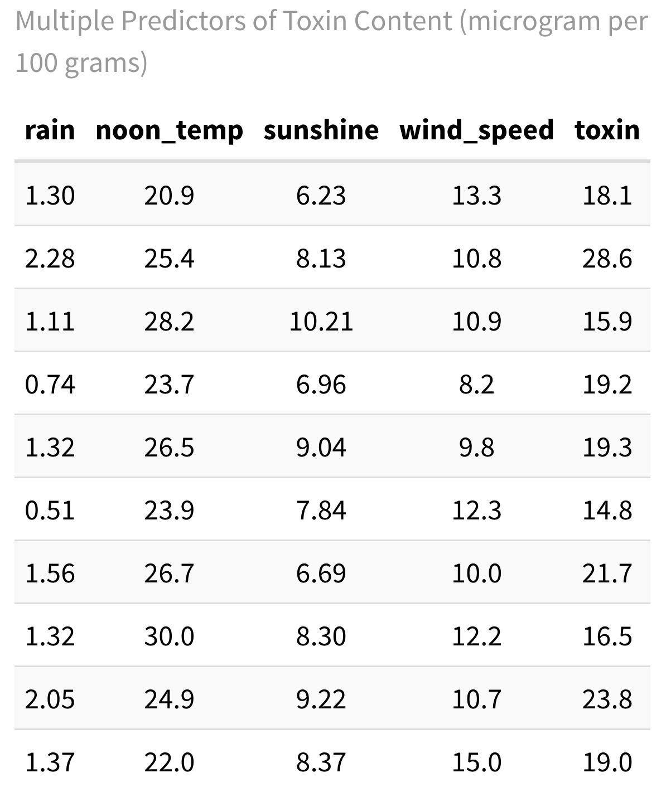
Multiple Linear Regression Example
We have 4 potential predictors of concentration of fungal toxin in nuts (μg per 100g).
rainfall - average amount of rainfall in cm per week
noon_temp - average temperature (degrees Celsius) at noon
sunshine - average number of hours per day of sunshine
wind_speed - average wind speed in km per hour

Slide 37
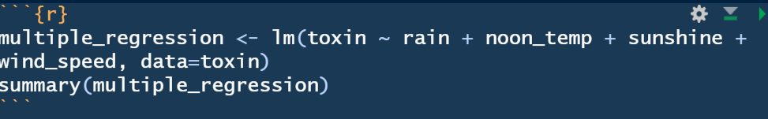
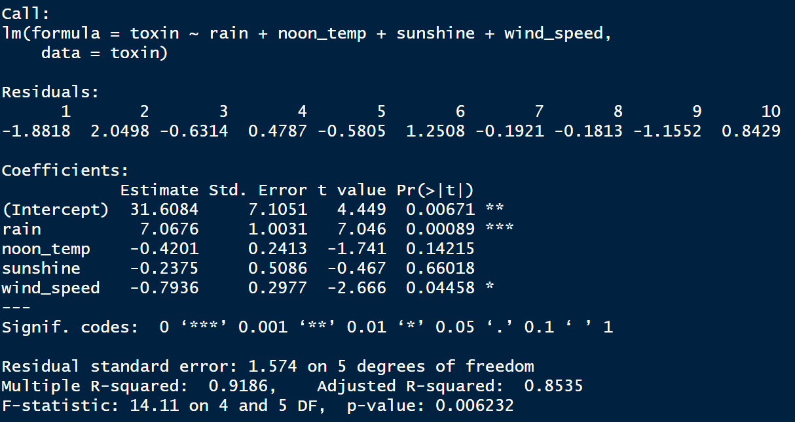
Code/Results in R

Slide 38
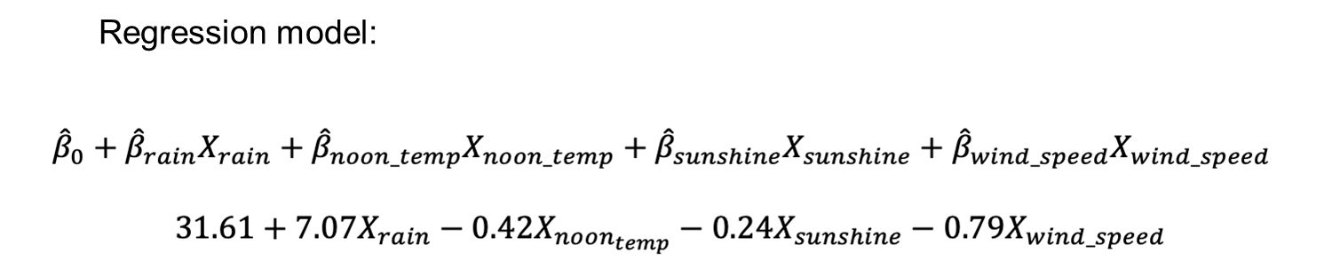

Slide 39
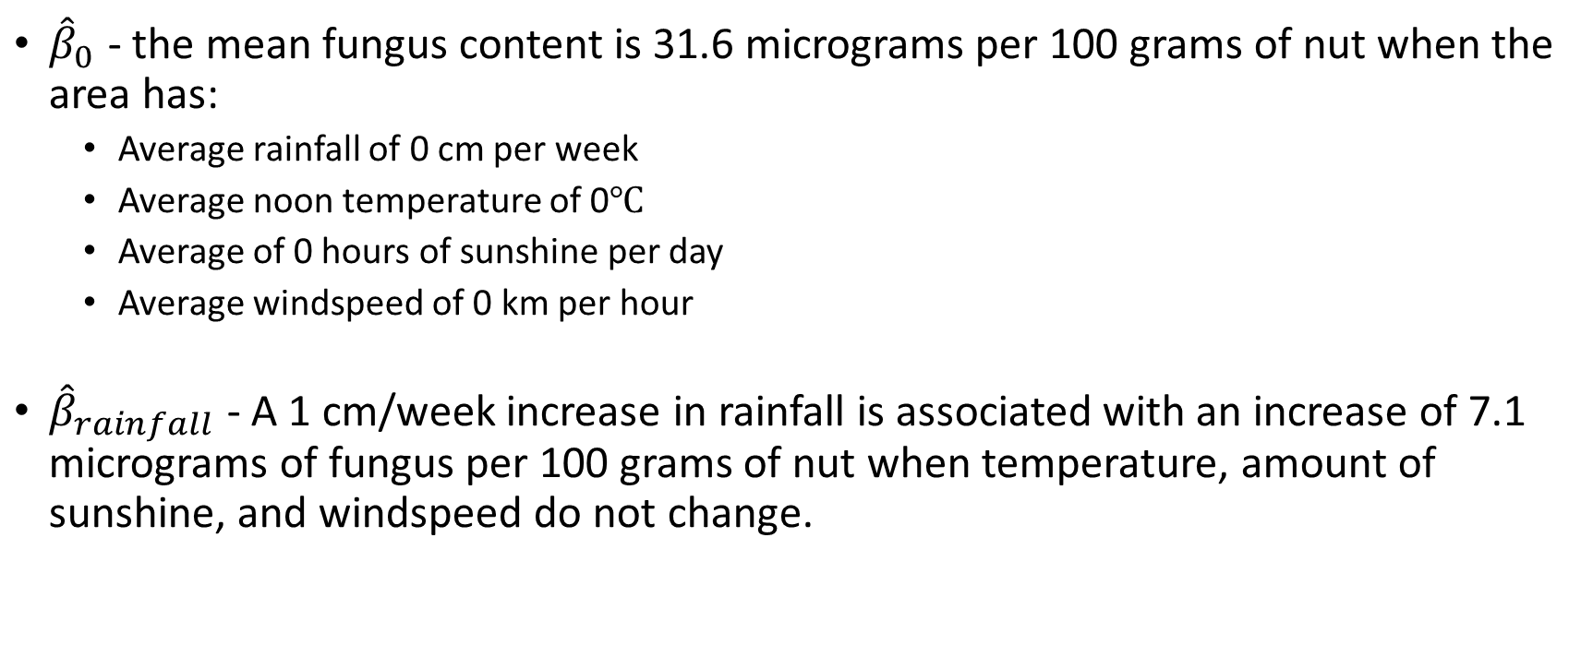
Interpretation of regression coefficients
${\hat{β}}_{0}$ - the mean fungus content is 31.6 micrograms per 100 grams of nut when the area has:
Average rainfall of 0 cm per week
Average noon temperature of 0℃
Average of 0 hours of sunshine per day
Average windspeed of 0 km per hour
${\hat{β}}_{rainfall}$ - A 1 cm/week increase in rainfall is associated with an increase of 7.1 micrograms of fungus per 100 grams of nut when temperature, amount of sunshine, and windspeed do not change.

Slide 40
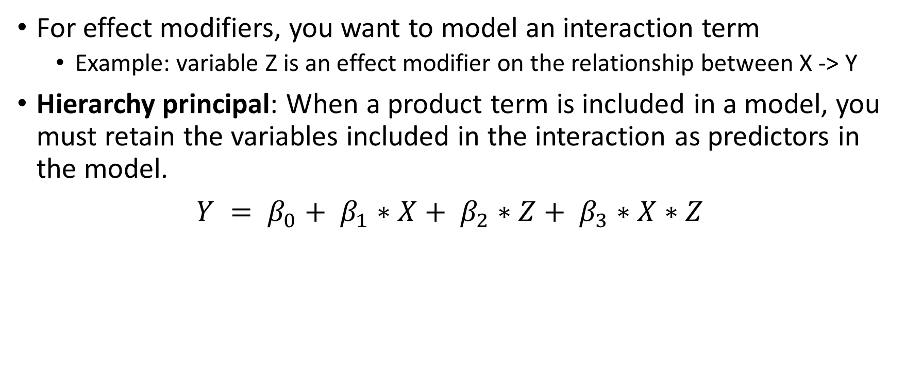
Interaction Effects
For effect modifiers, you want to model an interaction term
Example: variable Z is an effect modifier on the relationship between X -> Y
Hierarchy principal: When a product term is included in a model, you must retain the variables included in the interaction as predictors in the model.
$Y = β_{0}+ β_{1}∗X+ β_{2}∗Z+ β_{3}∗X∗Z$

Slide 41
Interaction Example
We are interested in the effect of rainfall (potential predictor) of concentration of fungal toxin in nuts (μg per 100g). However, there is previous studies that have shown this relationship also depends on how hot the temperature is.
rainfall - average amount of rainfall in cm per week
noon_temp – average temperature (degrees Celsius) at noon
For ease of interpretation in modeling, we are going to stratify our noon_temp as being low or high (depending on if it’s below or above the median temperature value).

Slide 42
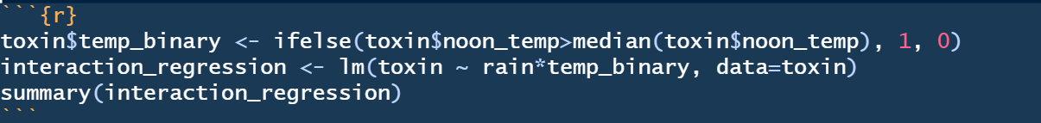
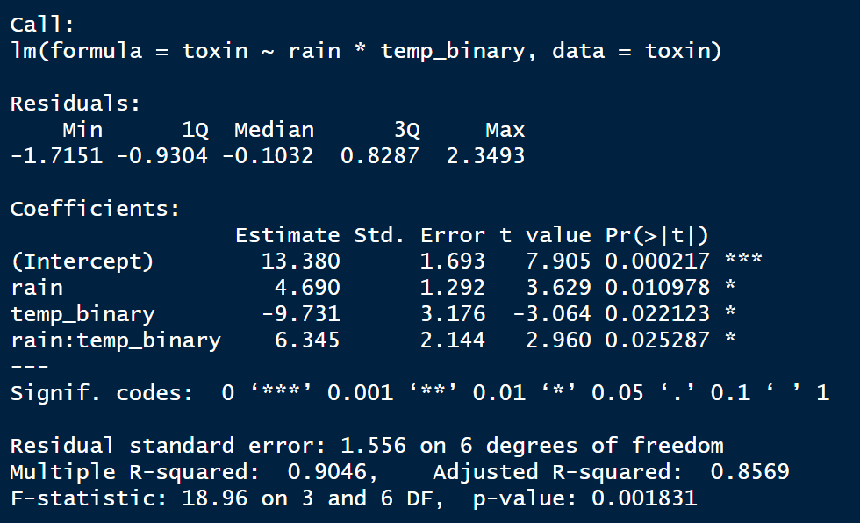
Code/Results in R
CAUTION: in R using an * automatically includes all lower order effects (i.e. main effects)
In SAS this is NOT the case and need to hard code this.

Slide 43
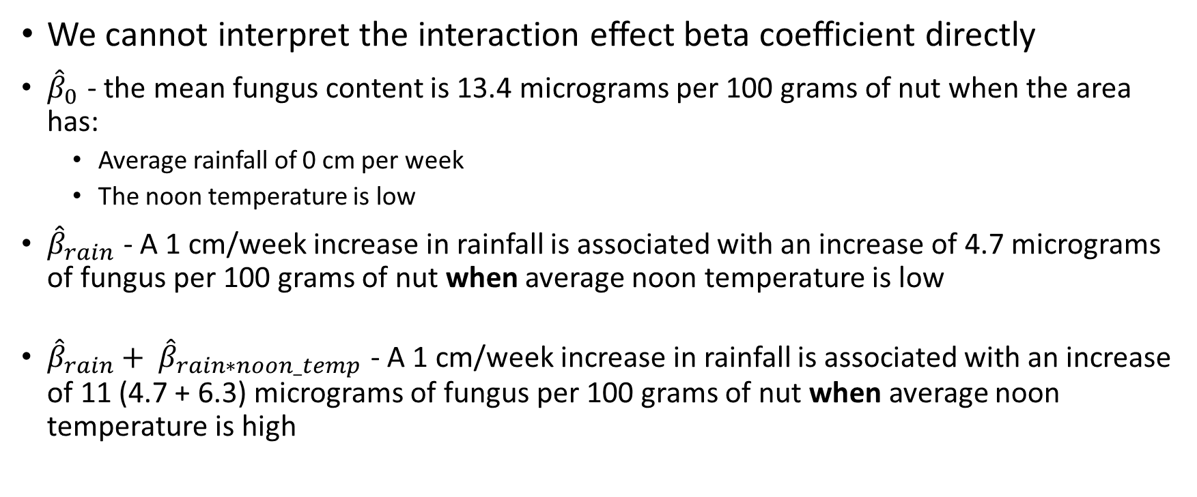
Interpretation of Interaction Coefficients
We cannot interpret the interaction effect beta coefficient directly
${\hat{β}}_{0}$ - the mean fungus content is 13.4 micrograms per 100 grams of nut when the area has:
Average rainfall of 0 cm per week
The noon temperature is low
${\hat{β}}_{rain}$ - A 1 cm/week increase in rainfall is associated with an increase of 4.7 micrograms of fungus per 100 grams of nut when average noon temperature is low
${\hat{β}}_{rain}+ {\hat{β}}_{rain∗noon_temp}$ - A 1 cm/week increase in rainfall is associated with an increase of 11 (4.7 + 6.3) micrograms of fungus per 100 grams of nut when average noon temperature is high

Slide 44
Hypothesis tests for individual regression coefficients
Null Hypothesis: There is no linear association between the explanatory variable i and the outcome when the other explanatory variables are held constant
Alternative Hypothesis: There is an association between the explanatory variable i and the outcome when the the other explanatory variables are held constant.

Slide 45
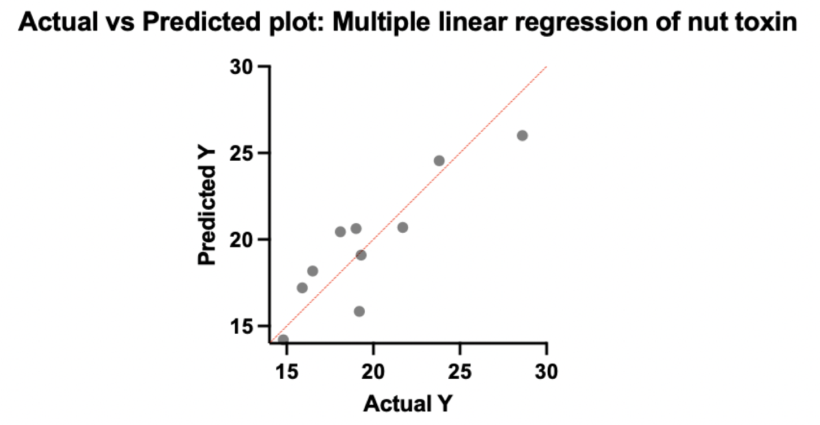
Linear Regression Assumptions
Linearity assumption: The relationship between the mean response and the explanatory variables is linear in the explanatory variables.

Slide 46
Linear Regression Assumptions
Assumptions about errors:
The errors are assumed to follow a normal distribution.
The errors have a mean of zero.
The errors have constant variance (homoscedasticity or homogeneity of variance).
The errors are independent of one another.

Slide 47
Linear Regression Assumptions
Assumptions about explanatory variables
The explanatory variables are nonrandom (fixed).
The explanatory variables are not highly correlated with one another.

Slide 48
Linear Regression Assumptions
Assumption about observations: All observations are equally reliable and have approximately equal role in determining the regression results in influencing conclusions.

Slide 49
Model Selection
If we have several explanatory variables, there are many models we may potentially fit. How do we choose which one is best?
There is no best model. In general, we want the simplest model that adequately explains the data, e.g., the most parsimonious model.

Slide 50
Backward selection
Start with all variables and drop one variable at a time.
The variable with the largest p-value is considered for removal. The variable is removed if it is not significant, and a new model (excluding that variable) is fit.
Variables are removed in this way until all variables in the model are significant.

Slide 51
Forward selection
Start with only an intercept in the model.
Look for the variable most associated with the response variable. If this regression coefficient is significantly different from zero a search for a second variable is made.
The next variable selected is the most highly correlated with the residuals from the model with the first explanatory variable. If this regression coefficient is significantly different from zero, a search for a third regression variable is made.
This process continues until there are no additional variables that are significantly different from zero.

Slide 52
Evaluate potential confounding
Instead of solely relying on p-values, look at the effect size f your primary explanatory variable (i.e. β estimate) change between including and excluding the potential confounder
If percent change ≥ 10%, include the variable
$$Percent Change= \frac{β_{with potential confounder }− β_{without potential confounder}}{β_{without potential confounder}}∗100$$

Slide 53
Choosing a model
“When there is sound theoretical literature available, you base your model upon what past research tells you.”
e.g., in human genetics studies age, gender, and ethnicity are often always included in the regression model regardless of whether or not they significantly contribute.
Use caution when using an automated selection method (i.e., forward or backward selection)
These methods rely on a mathematical criterion instead of human intelligence.
Variable selection may depend upon only slight differences in significance. Slight numerical differences can lead to major differences in the model.
Backward selection is preferred (not applicable if the number of predictors is larger than the number of observations).

Slide 54
Model Fit: Coefficient of Determination
Coefficient of determination, R² - measures the proportion of total response variation explained by the linear regression model with p-1 explanatory variables compared to the regression model with only an intercept.
R² measures the relative reduction in the residual sum of squares for our regression model in comparison to the model having only an intercept.
When R² is close to 1, the regression model explains a high proportion of the variation in the observed data compared to the simplest model.

Slide 55
Adjusted Coefficient of Determination
Since the coefficient of determination, R², measures the proportion of additional variance explained by the regression model in comparison to the simple model (just an intercept), it may seem like a reasonable statistic to choose between models.
However, R² will never decrease, and almost always will increase, as you add explanatory variables to the model.
If R² is used to choose between models, we will always choose the model with the most explanatory variables.
This is NOT a good thing. We may make our model too complex. This is called overfitting.

Slide 56
Summary of Multiple Linear Regression
Regression can be extended to multiple regression, allowing several factors to participate in the prediction of the dependent variable.
Regression coefficients are interpreted in the context that the other explanatory variables are held constant.
The most parsimonious model can be found using either backward (preferred when the number of explanatory variables is smaller than the number of observations) or forward selection.

Slide 57
Logistic Regression
Regression Analyses

Slide 58
What is Logistic Regression?
Logistic regression is a type of regression used when the responses are binary.

Slide 59
Why not use linear regression?
0 ≤ π ≤ 1, but the linear regression model doesn’t make this constraint.
Var(Y) = π(1-π), where π is dependent on x. Therefore, the variance of Y is not constant for all values of the explanatory variable, i.e., homogeneity of variance isn’t satisfied.
If Y_{i} = β₀ + β₁X_{i} + ϵ_{i}, then the errors ϵ_{i} are not normally distributed.

Slide 60
Generalized linear model
Logistic regression is a type of generalized linear model.
A generalized linear model is a model in which the mean relationship between the response variable and the explanatory variables is linear in the regression coefficients AFTER some transformation of the mean function.
In this case, the logit transformation does the work for us.

Slide 61
Probability of an event vs. logit of the probability
Scenario | Odds = P/(1-P) | Logit = ln(Odds)
No probability of an event (P=0) | 0/(1-0) = 0 | ln(0) = -∞
Neutral point (P=0.5) | 0.5/(1-0.5) = 1 | ln(1) = 0
Certainty of about event (P=1) | 1/(1-1) = ∞ | ln(∞) = +∞

Slide 62
Logistic Regression Example
A questionnaire has been used to gather demographics data from some pharmacists, the data include their age and gender.
It also asked ‘Would you personally be happy to provide training in the use of the App? (Yes/No)’
We are concerned with the influence of age on pharmacists’ willingness to train patients in use of a phone App.

Slide 63
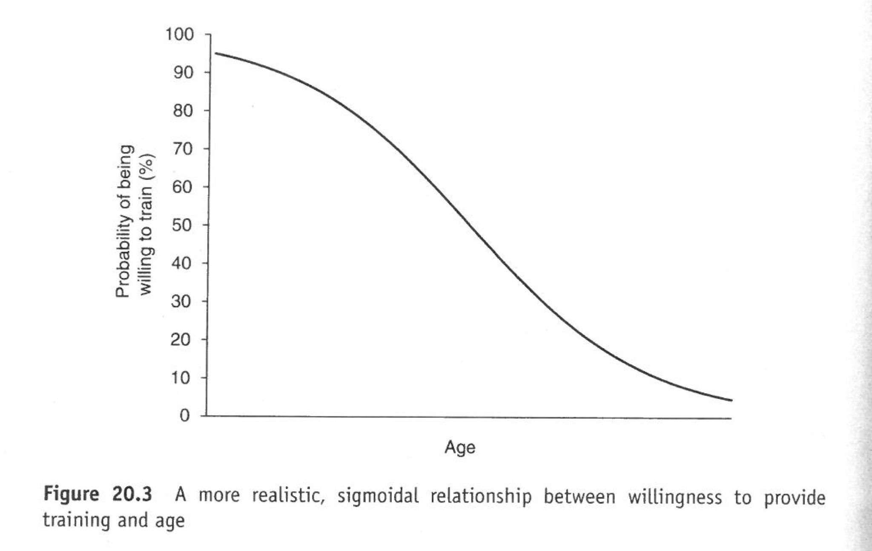

Slide 64
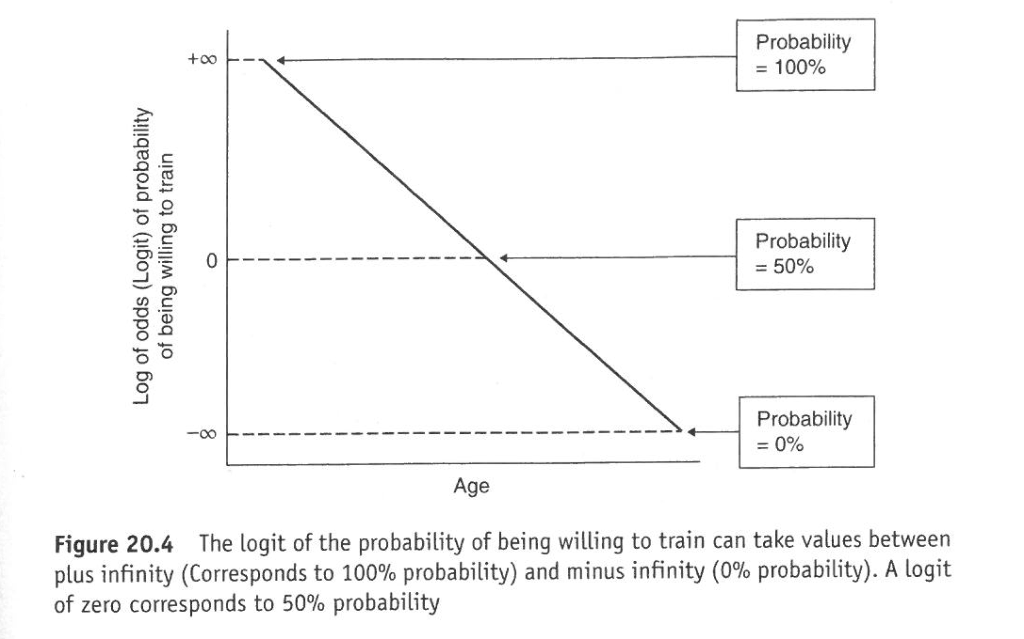

Slide 65
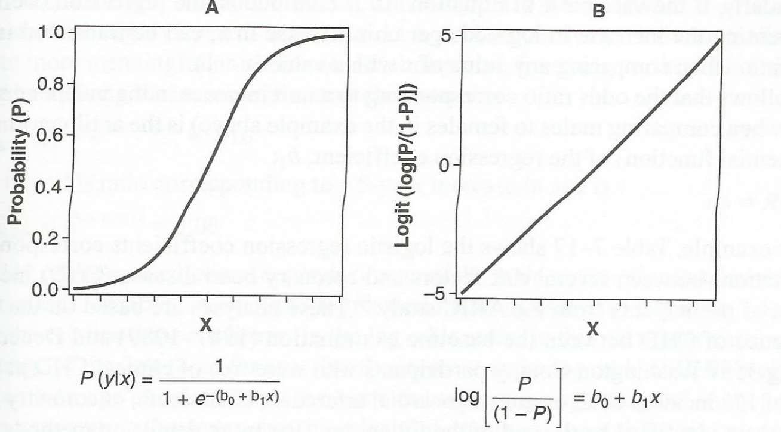
Szklo & Nieto, Beyond the Basics, 2nd Ed, Ch.7

Slide 66
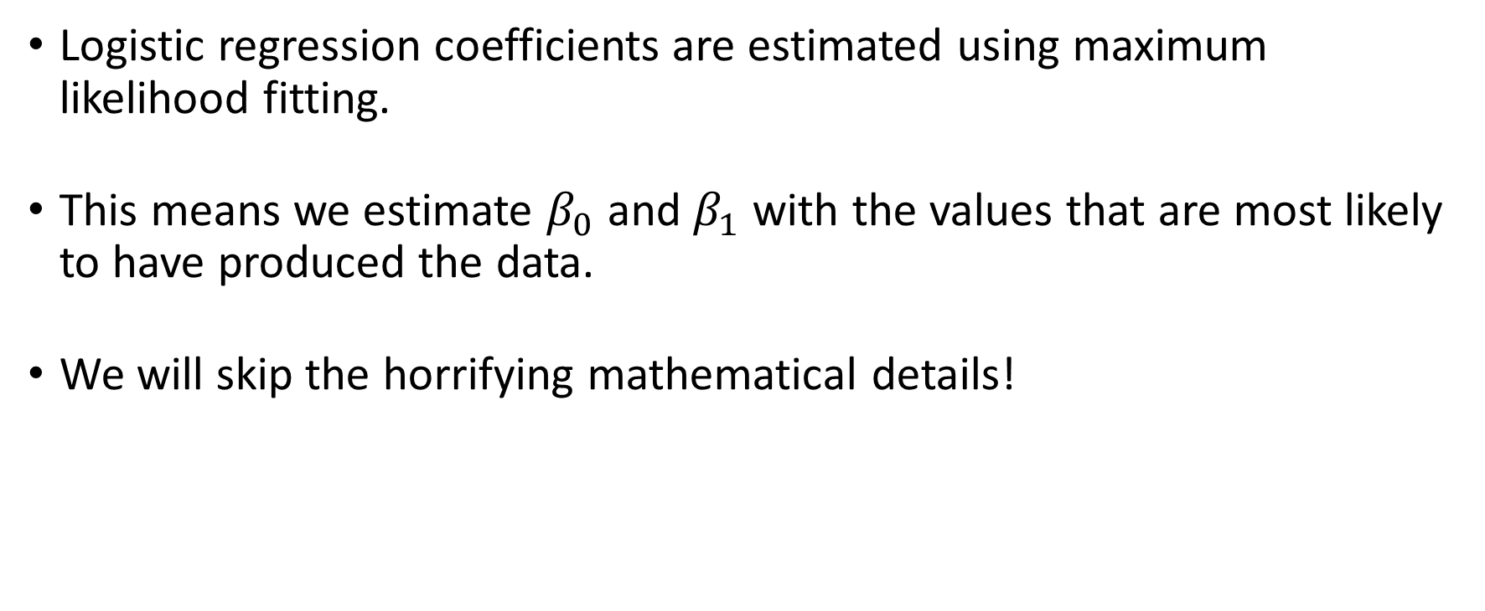
Estimation of Logistic Regression Coefficients
Logistic regression coefficients are estimated using maximum likelihood fitting.
This means we estimate $β_{0}$ and $β_{1}$ with the values that are most likely to have produced the data.
We will skip the horrifying mathematical details!

Slide 67
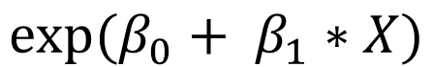
Interpretation of Logistic Regression Parameters
$$exp⁡(β_{0}+ β_{1}∗X)$$

Slide 68
Let’s compare the ratio of the odds when the explanatory variable is X+1 relative to when it is X, i.e., X increases by 1.
The odds ratio in this case is
Thus, the odds change by a multiplicative factor of exp(β₁) when X increases by 1 (i.e. effect of 1 unit of X has an odds ratio of exp(β₁) )

Slide 69
Coefficients and Odds Ratios (ORs)
Regression coefficients can range from -∞ to +∞. Values less than 0 indicate a reduction in the probability of an event. Values greater than 0 indicate an increase in the probability of an event.
Odds Ratios can range from 0 to +∞. Values less than 1 indicate a reduction in the probability of an event. Values greater than 1 indicate an increase in the probability of an event.

Slide 70
Odds Ratio from Coefficients
If one pharmacist is one year older than another, the odds that the older pharmacist will be willing to train will be 0.912 times those for the younger individual.

Slide 71
Assessing the effectiveness of the model
Can visualize with a 2x2 contingency table
Classify each participant (or sample) as a:
true positive - predicted to have event and had event
true negative - predicted to not have an event and did not have an even
false positive- predicted to have event, but did NOT have event
false negative - predicted to NOT have event, but had event

Slide 72
Classifying participants in example
 | Observed to be willing | Observed to be not willing
Predicted as willing | True positive = 116 | False positive = 45
Predicted as not willing | False positive = 29 | True negative = 46

Slide 73
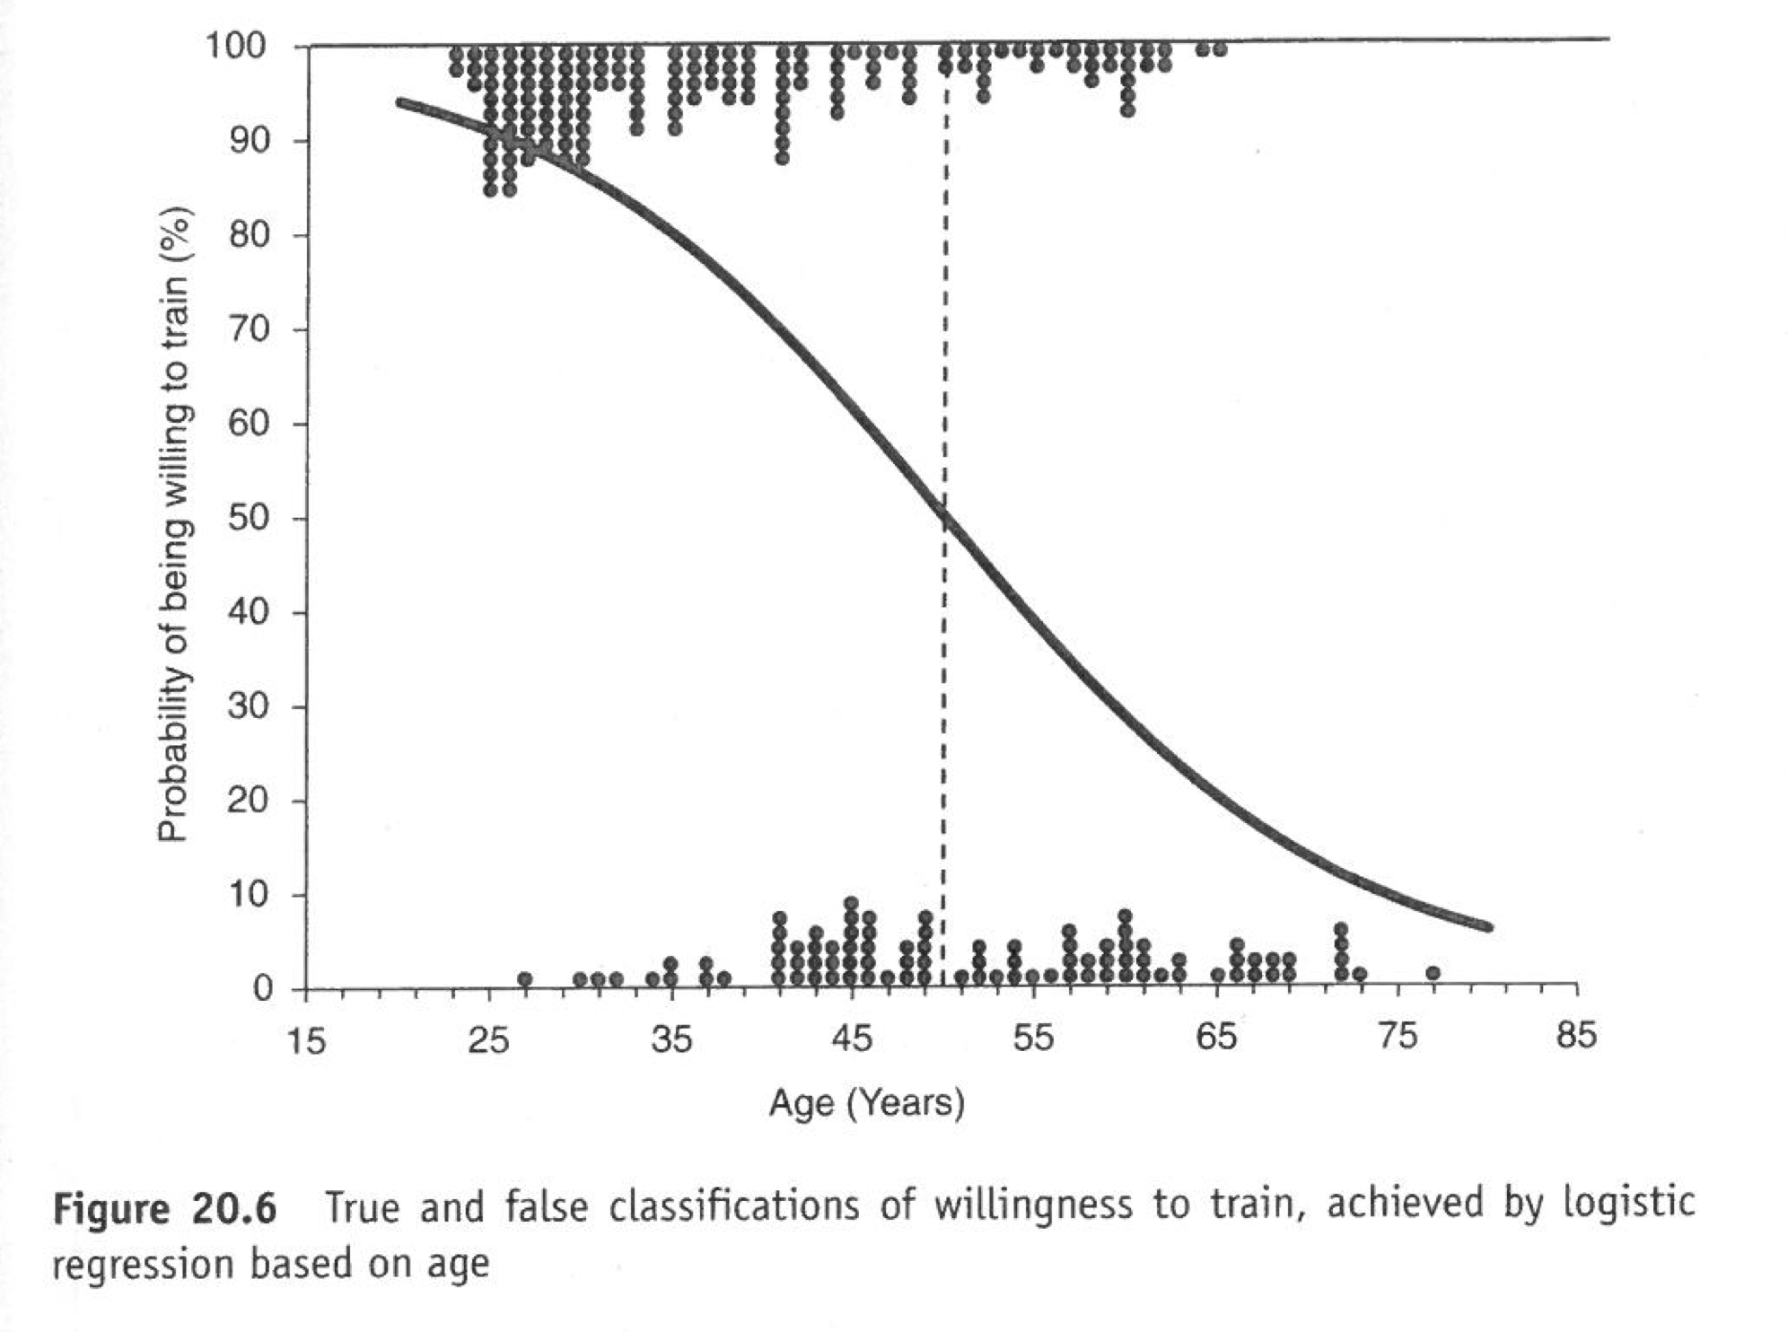

Slide 74
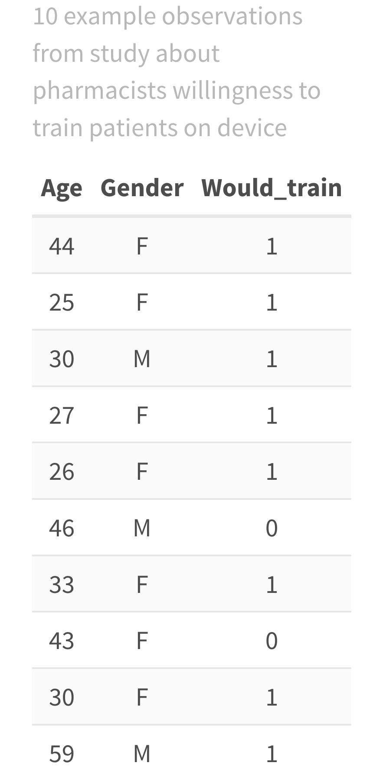
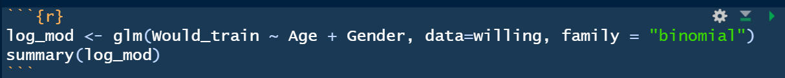
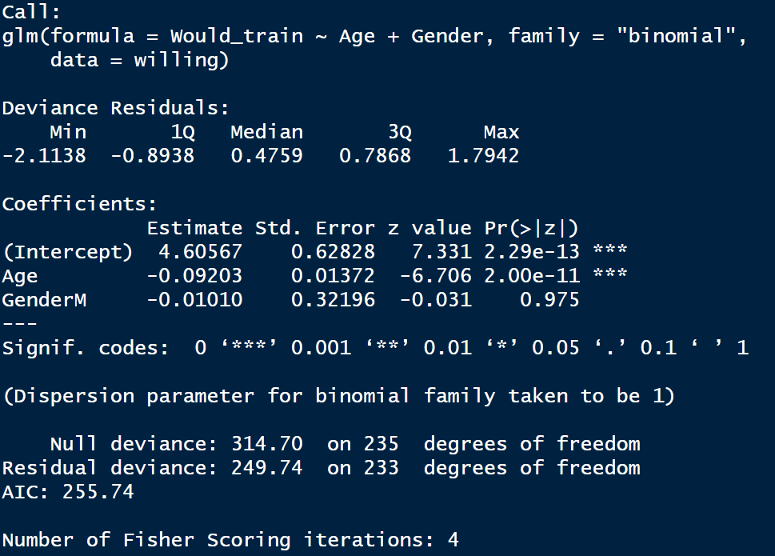
Code/Results in R

Slide 75
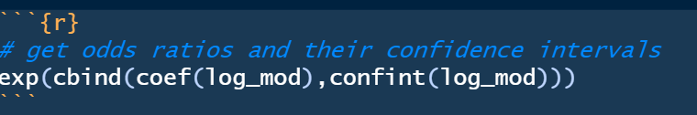
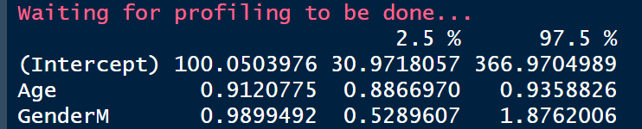
Code/Results for ORs
In the multiple logistic regression model, age was negatively associated with the probability of the pharmacist being willing to train patients (odds ratio = 0.91; 95% CI for OR = 0.89 to 0.94; p-value<0.0001). There was no association between gender and the probability of a pharmacist being willing to train patients (p-value = 0.98).

Slide 76
Summary of Logistic Regression
Logistic regression allows us to determine the influences nominal and/or interval factors have on a dichotomous nominal outcome.
With a logistic regression equation, we can predict the likelihood that a given individual will fall into a particular category by taking account of one or more factors.
The Odds Ratio of a factor describes the multiplicative effect on the odds of an event when the factor is increases in the value by 1.0.

Slide 77
Conclusions

Slide 78
What Did We Learn?
Regression analysis is often used when the goal is to predict the outcome based on one or more variables or when the goal is to understand the relationship between two variables when ”controlling” for other variables, i.e., when other variables don’t change.
There are several types of regression analyses that depend on the nature of the outcome variable, e.g., continuous, binary.
Effect size between a predictor and the outcome is measured as a ‘regression coefficient’.

